Slide 1
Identifying the Genetic Basis for Human Disease

Slide 2
Approaches for identifying genes/variants causing disease:
Linkage analysis: tests for coinheritance of disease with a particular genomic region or variant
Association analysis: tests for increased frequency of a particular allele in affected individuals as compared to controls
Genome sequencing: tests sequences of whole genome of patient and parents

Slide 3
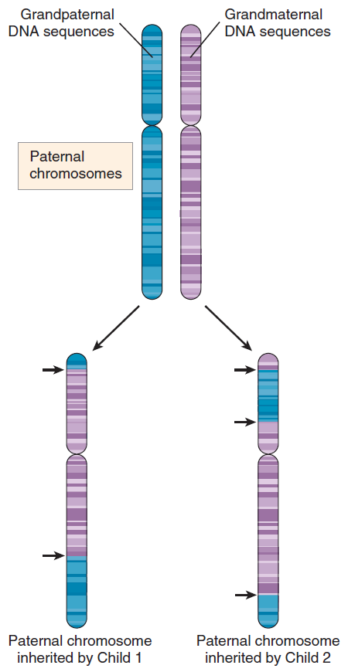
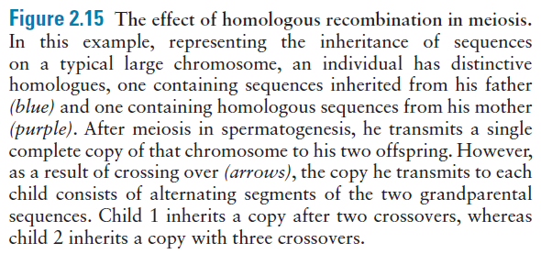

Slide 4
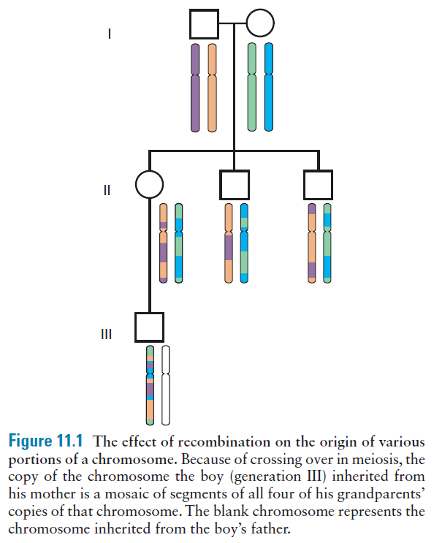

Slide 5
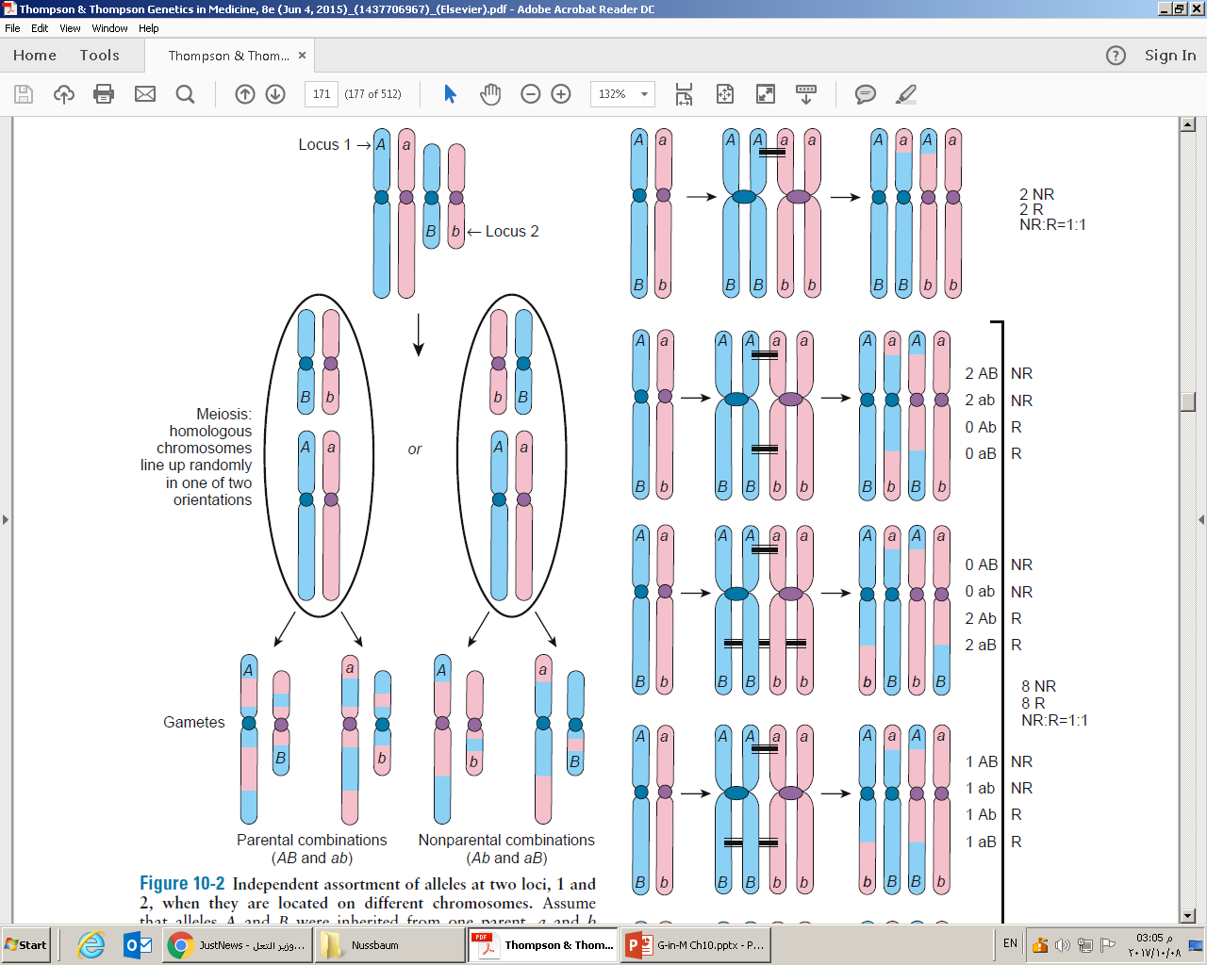
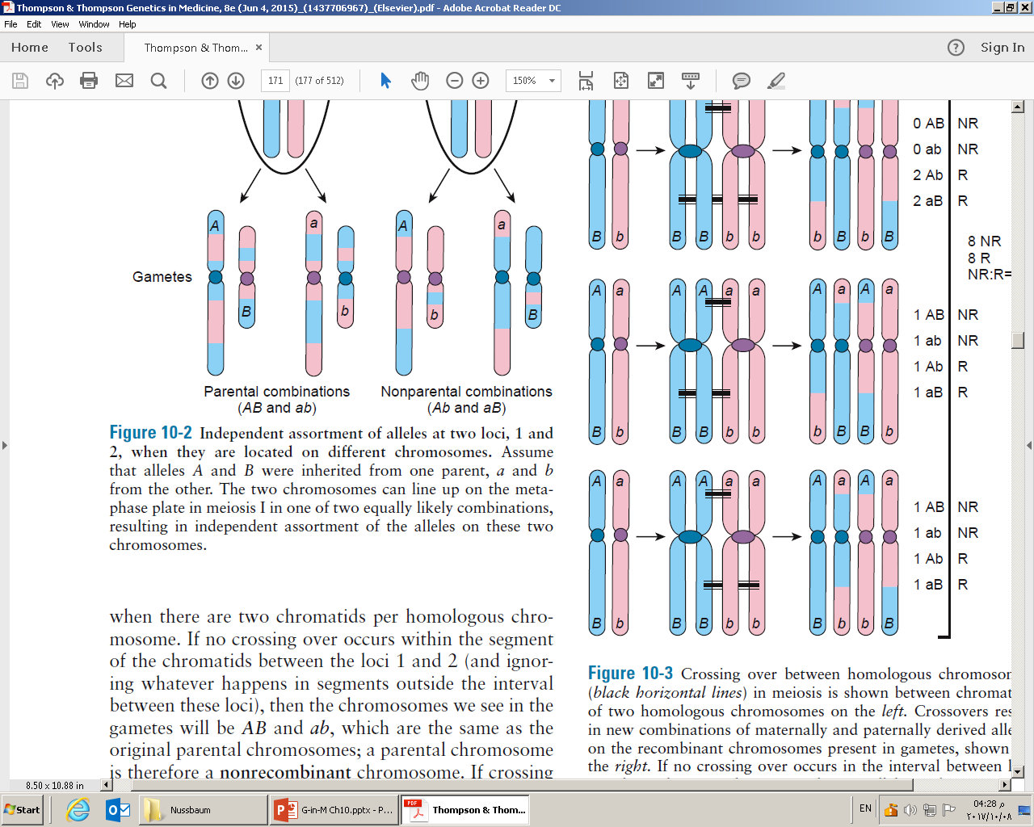
Figure 11-2
On average, half (50%) of gametes will be parental (AB or ab) and 50% nonparental (Ab or aB).

Slide 6
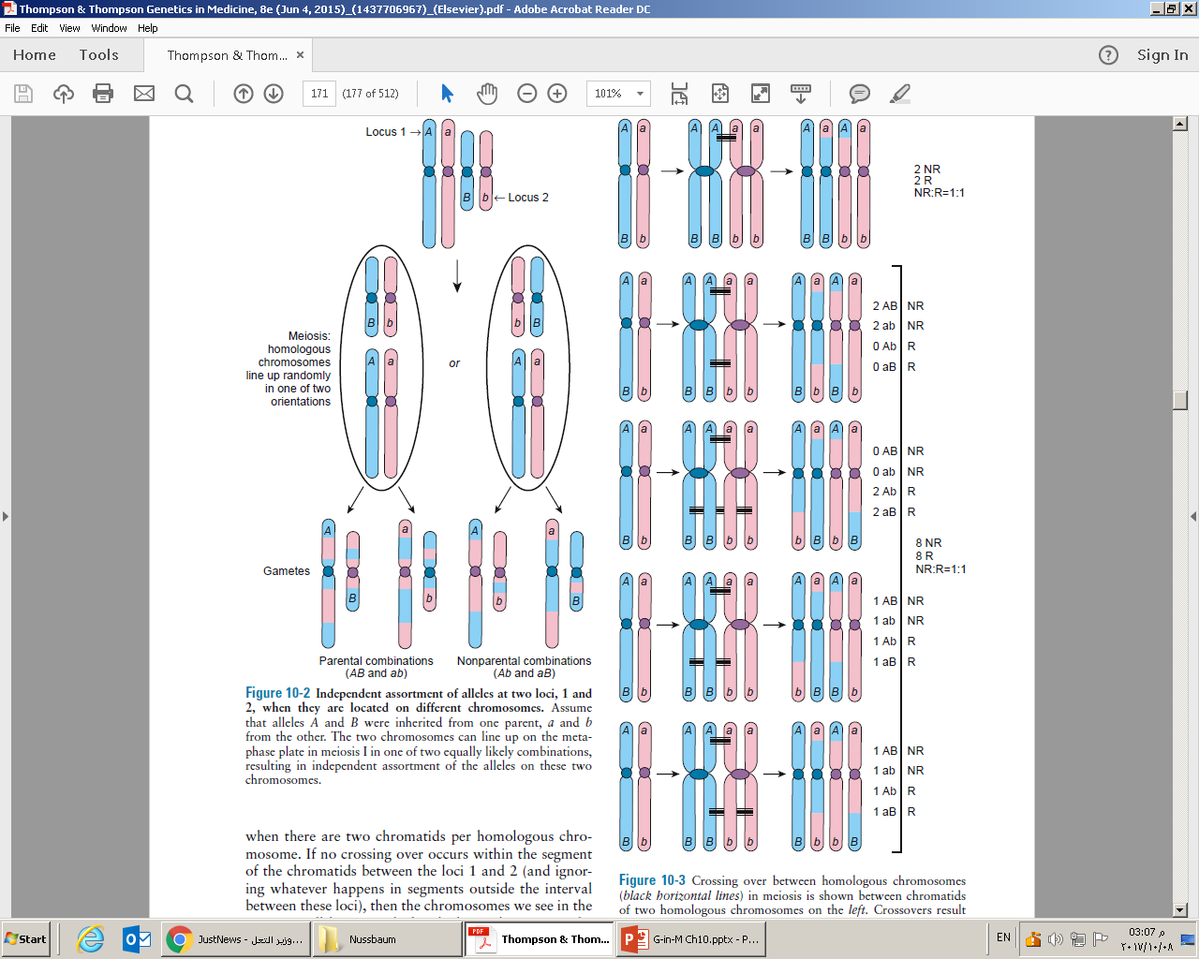
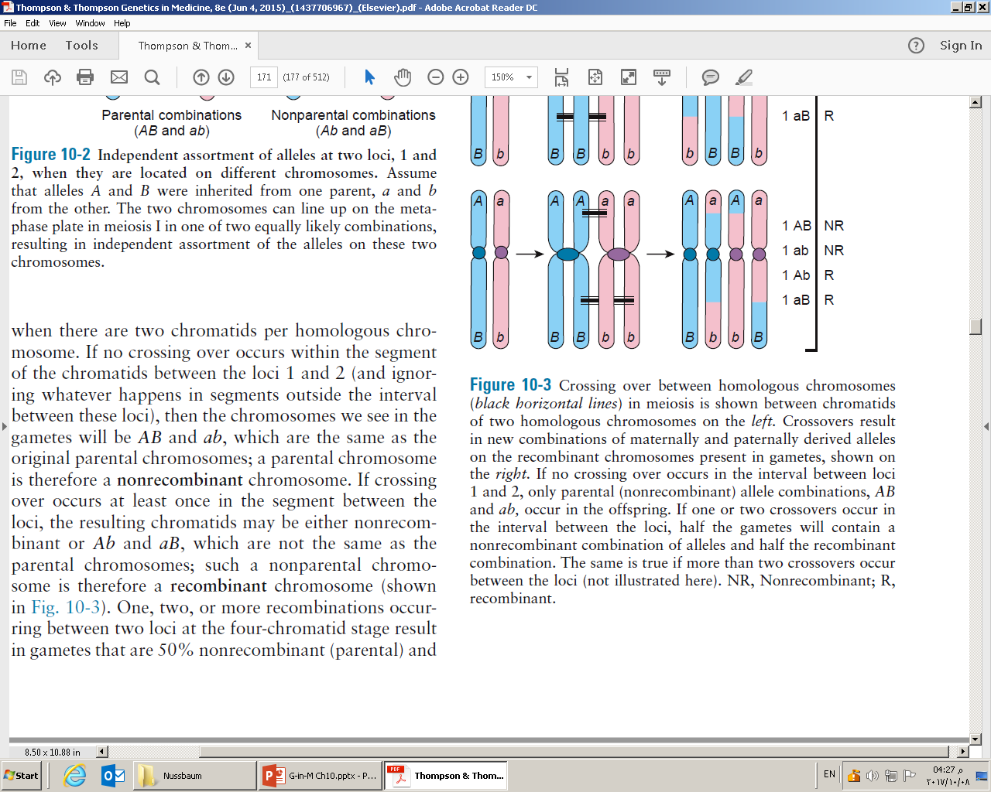
Figure 11-3

Slide 7
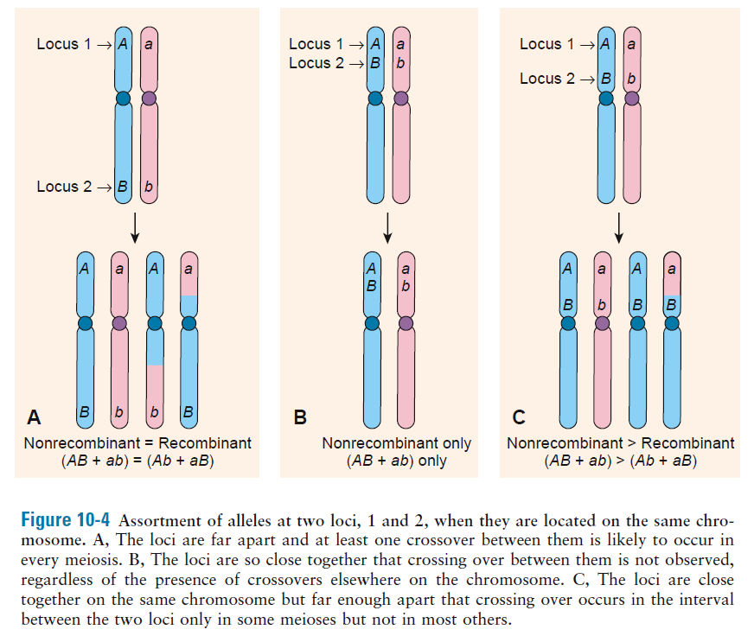
The closer together two loci are, the smaller the recombination frequency, and the fewer recombinant genotypes are seen in the offspring
Figure 11-4

Slide 8
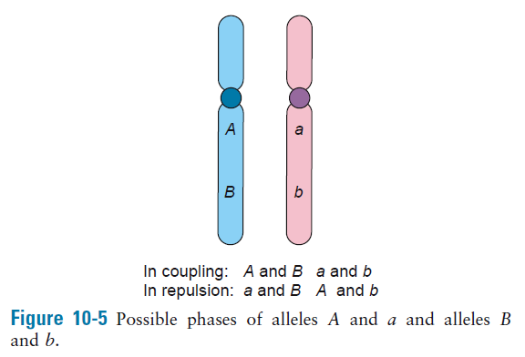
Figure 11-5
Detecting the recombination events between loci requires:
A parent be heterozygous (informative) at both loci
Knowledge of which allele at locus 1 is on the same chromosome as which allele at locus 2 (phase)

Slide 9
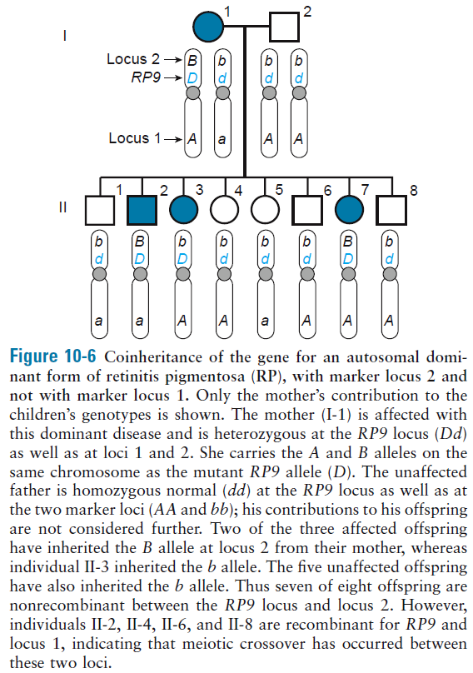
Figure 11-6

Slide 10
Linkage and recombination frequency
Linkage: describes a departure from independent assortment of two loci; tendency for alleles at loci that are close together on the same chromosome to be transmitted together, as an intact unit, through meiosis
Determining the frequency of recombination as a measure of how close two loci are to each other on a chromosome
Recombination frequency θ
θ = 0 (no recombination, completely linked)
θ = 0.5 (independent assortment, unlinked)

Slide 11
Map distance between two loci is a theoretical concept based on actual data – extent of observed recombination, θ, between the loci
Unit: centiMorgan (cM), the genetic length over which, on average, one crossover occurs in 1% of meioses
Genetic length of human genome measured in female meiosis is 4596 cM, 60% greater than length measured in male meiosis 2868 cM
Sex averaged genetic length is 3790 cM (~1.15 cM/Mb)

Slide 12
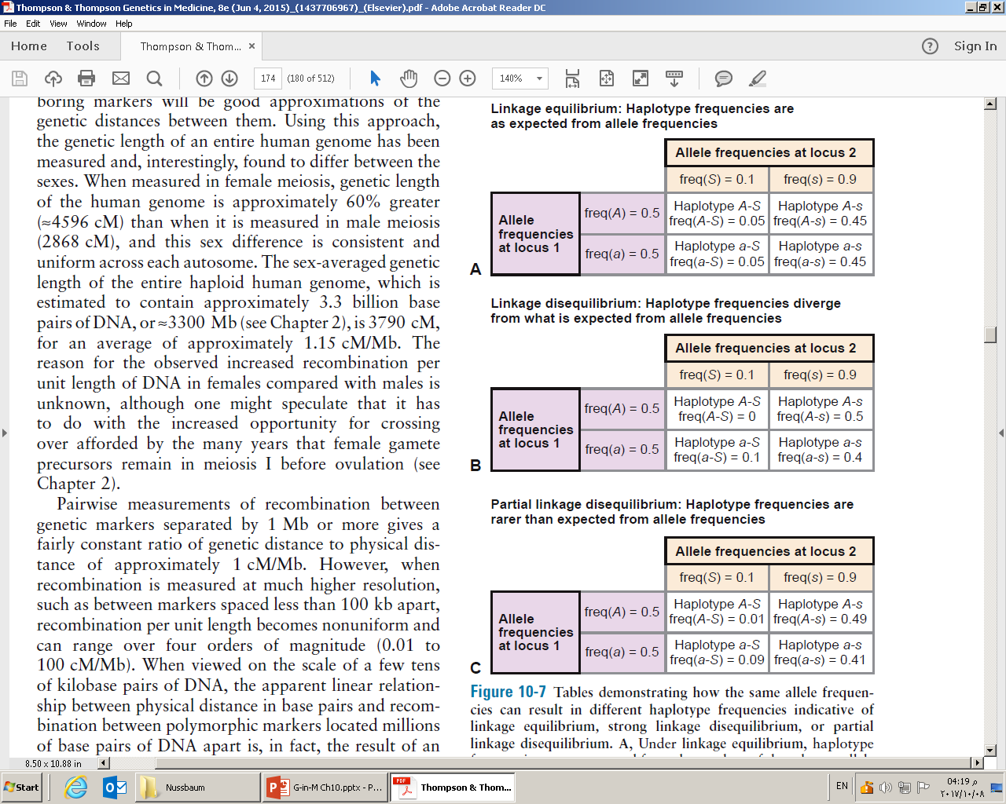
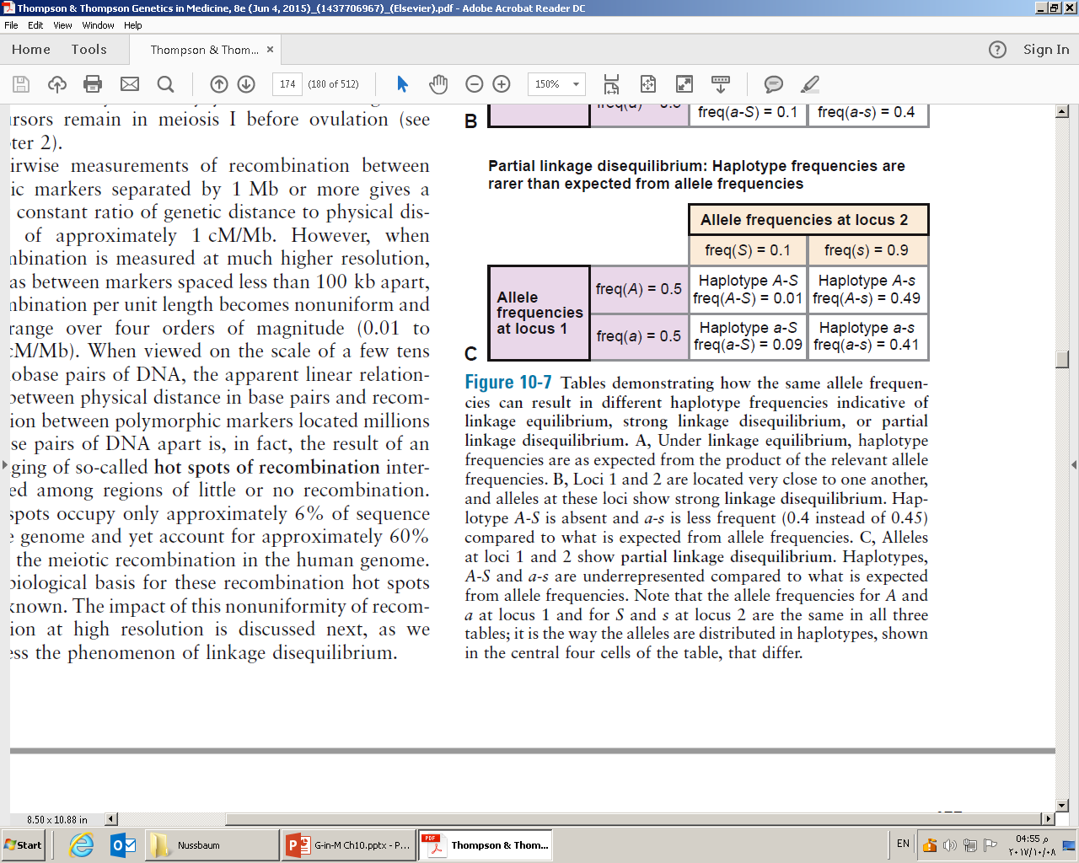
Linkage disequilibrium
Freq(A-S)≠freq(A)*freq(S)
Figure 11-7
Deviation (delta) between expected and actual haplotype frequencies:
D = freq(A-S)*freq(a-s) – freq(A-s)*freq(a-S)
If D = 0 then it is LE
If D ≠ 0 then it is LD

Slide 13
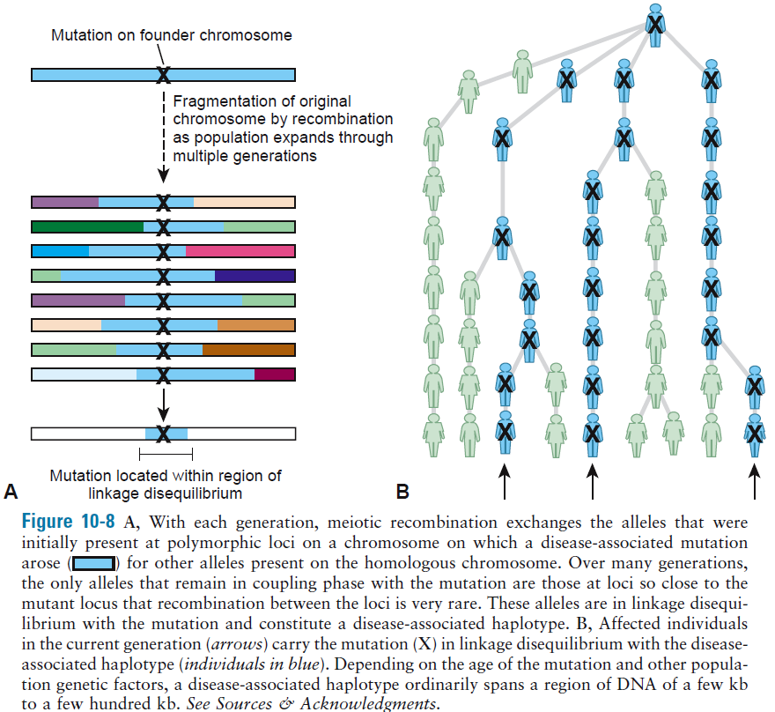
# of generations
Freq of recombination
Natural selection
Figure 11-8

Slide 14
D varies according to allele frequency
D’ corrects for the different allele frequencies
D’ = D/F
D = freq(A-S)*freq(a-s) – freq(A-s)*freq(a-S)
F is a correction factor that helps account for the allele frequencies
F = the smaller of freq(A)*freq(s) or freq(a)*freq(S) if D>0
F = the smaller of freq(A)*freq(S) or freq(a)*freq(s) if D<0
Different populations can have different values of D’ between the same two alleles at the same loci

Slide 15
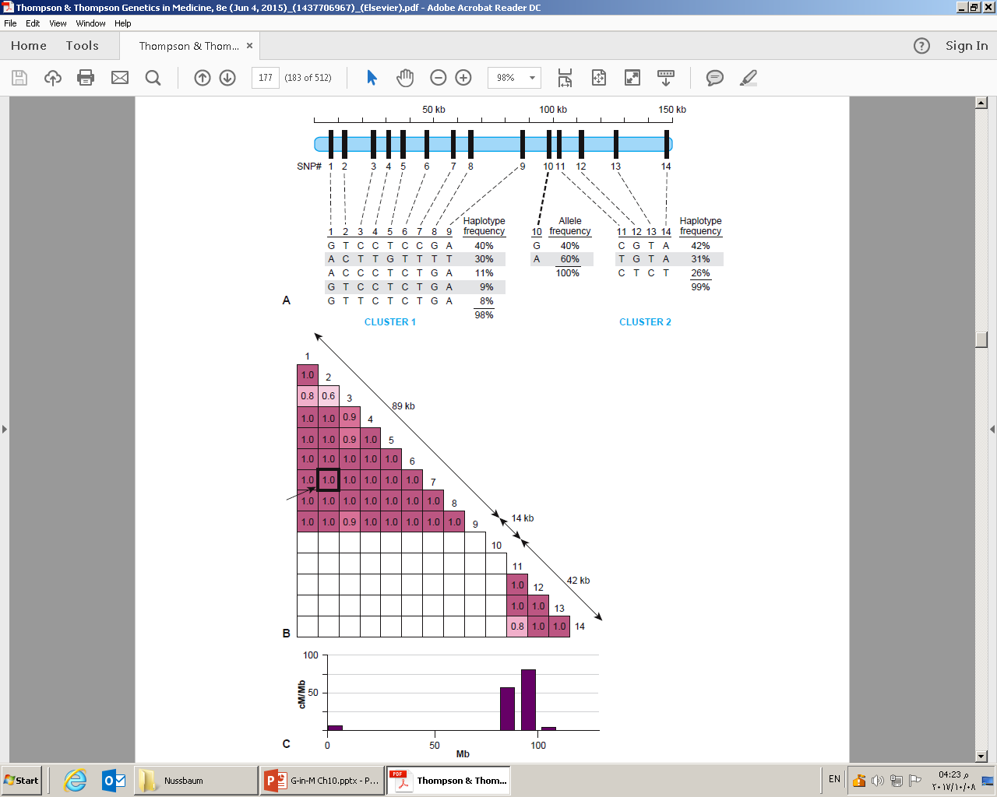
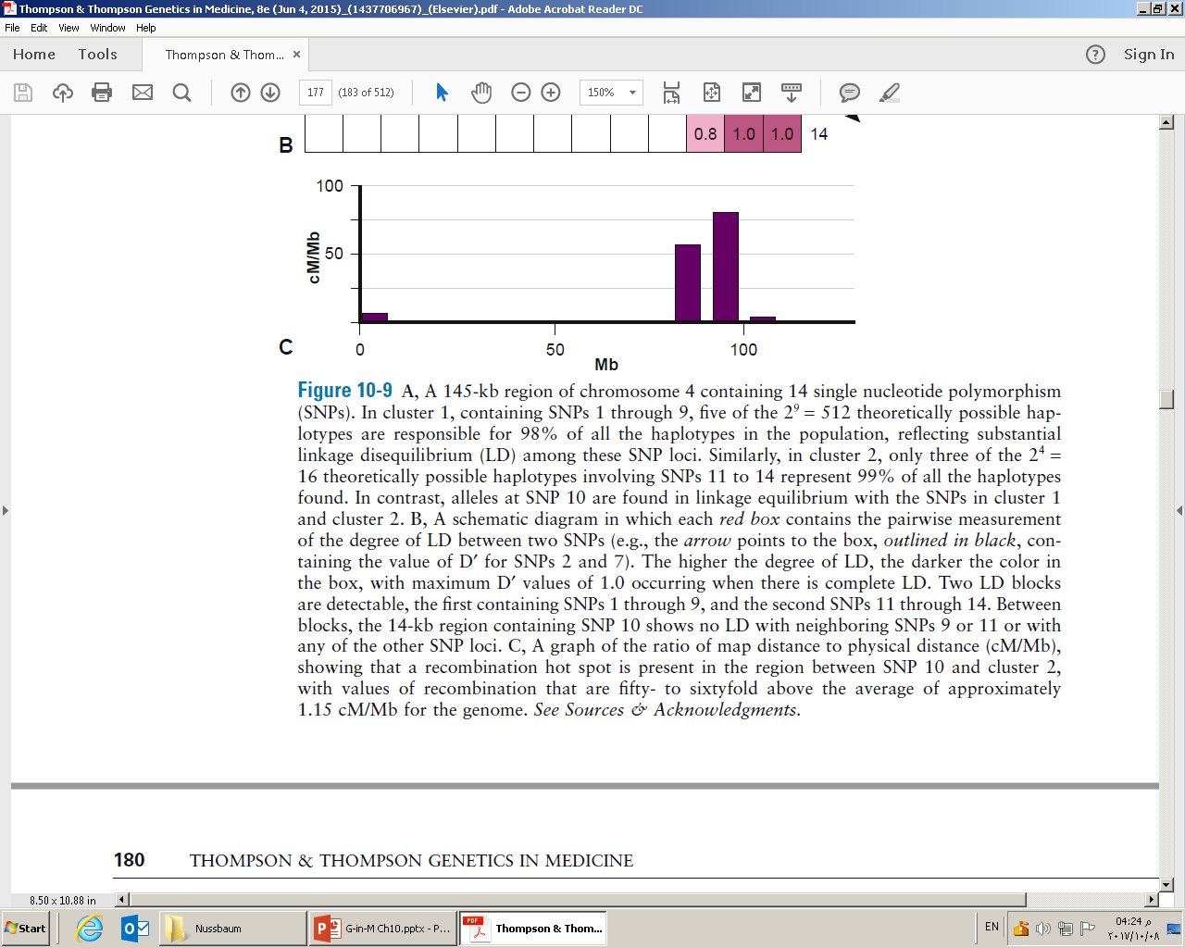
2⁹=512 different haplotypes
2⁴=16 different haplotypes
Figure 11-9
LD blocks: clusters of loci with alleles in high LD across segments of DNA
African average LD blocks 7.3 kb
Europeans: 16.3, Asians 13.2
Meiotic recombination hot spots

Slide 16
Linkage analysis is a method of mapping genes that uses studies of recombination in families to determine whether two genes show linkage when passed on from one generation to the next
Likelihood of the data if loci are linked at distance θ
Likelihood of the data if loci are unlinked (θ=0.5)
θ^{r}(1- θ)^{N-r}
(1/2)^{r}(1/2)^{N-r}
N: Number of individuals
r: Number of recombinant chromosomes
N-r: number of chromosomes that do not show recombination
θ: the unknown probability that a recombination will occur
1- θ: the probability that no recombination occurs

Slide 17
When the value of the likelihood ratio for all values of θ are calculated, the value of θ that gives the greatest value of this likelihood ratio is the best estimate of θ and is referred as θ_{max}
Likelihood ratio for different values of θ is usually expressed as the log₁₀ and is called the LOD score (Z) (Logarithm of the ODds)
Use of logarithms allows likelihood ratios calculated from different families to be combined by simple addition instead of having to multiply them together

Slide 18
θ^{r}(1- θ)^{N-r}
(1/2)^{r}(1/2)^{N-r}
θ¹(1- θ)⁷
(1/2)¹(1/2)⁷
You calculate it for different θs and you take maximum value as the real θ
Max LOD obtained at θ=0.125
0.125¹*0.875⁷ = 12.6
0.5¹*0.5⁷
LOD=1.1
Figure 11-6

Slide 19
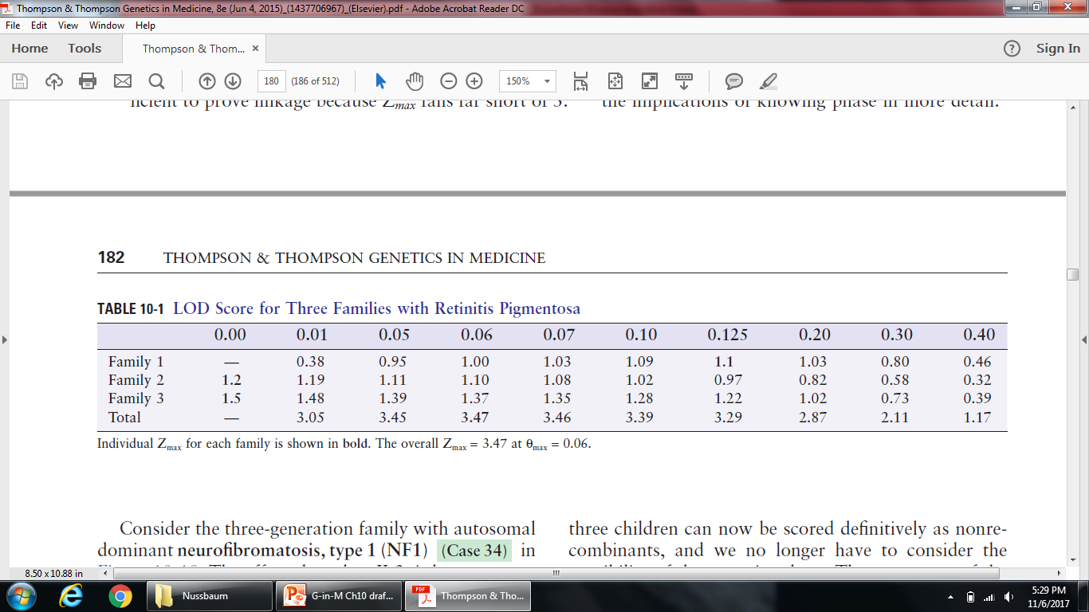
A LOD score of +3 or greater (equivalent to greater than 1000 : 1 odds in favor of linkage) is considered firm evidence that two loci are linked—that is, that θ_{max} is statistically significantly different from 0.5
Combining LOD scores across families
TABLE 11-1

Slide 20
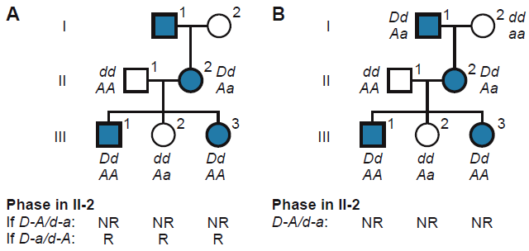
Phase unknown Phase known
½(θ)⁰(1-θ)³+½(θ)³(1-θ)⁰ (θ)⁰(1-θ)³
1/8 1/8
Z_{max}=0.6 at θ_{max}=0 Z_{max}=0.9 at θ_{max}=0
Knowing the phase increases the power to test for linkage

Slide 21
Gene Finding in a Common Mendelian Disorder by Linkage Mapping: Cystic Fibrosis (CF)
50 CF families were analyzed for linkage: 500-kb region on the long arm of chromosome 7
Significant LD between disease locus and a particular haplotype
Isolation of gene (CFTR) in 1989
ΔF508 in 70% of all mutant CF alleles in northern Europeans

Slide 22
Mapping human disease genes by association
Disease association: increased or decreased frequency of a particular allele in affected individuals, compared to that in unaffected individuals
Two study designs:
Case-control studies
Cross-sectional or cohort studies
A cross-sectional involves a single time point, a cohort study takes place over time

Slide 23
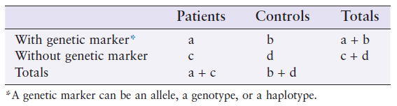
Odds ratios and relative risks
In case-control study, association between disease and genotype is calculated by odds ratio (OR):
OR= odds of an allele carrier developing disease = a/b = ad
odds of a noncarrier developing disease c/d bc

Slide 24
Odds ratios and relative risks
In cross-sectional or cohort study, association between disease and genotype is measured by relative risk (RR):
RR= proportion of those with disease who carry a particular allele
proportion of those with disease who do not carry that allele
= a/(a+b)
c/(c+d)

Slide 25
A common way of expressing whether there is statistical significance to an estimate of OR or RR is to provide a 95% confidence interval
The confidence interval is the range within which one would expect the OR or RR to fall 95% of the time by chance alone in a sample taken from the population
If a confidence interval excludes the value 1.0, then the OR or RR deviates significantly from what would be expected if there were no association

Slide 26
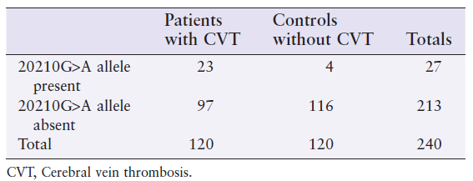
OR = 23/4 = 6.9
97/116
95% confidence interval 2.3 to 20.6
This demonstrates strong and statistically significant association between the allele and CVT
Individuals carrying the allele have seven times greater odds of having the disease

Slide 27
Genome-wide association studies (GWAS)
Genotyping cases and controls for ~ 1 million variants located throughout the genome to search for association with the disease
Haplotype mapping (HapMap) project
characterize the distribution of LD blocks across different ethnicities of the human genome
1000 Genomes project

Slide 28
Finding the genes contributing to a complex disease by genome-wide association. e.g. Age-related macular degeneration (AMD)
GWAS revealed association of SNPs in complement factor H (CFH) gene
Tyr402His variant is less protective against inflammation
A bigger GWAS involving 7600 cases and 50,000 controls revealed 19 loci associated with AMD p<5x10⁻⁸ , e.g. ARMS2 gene

Slide 29
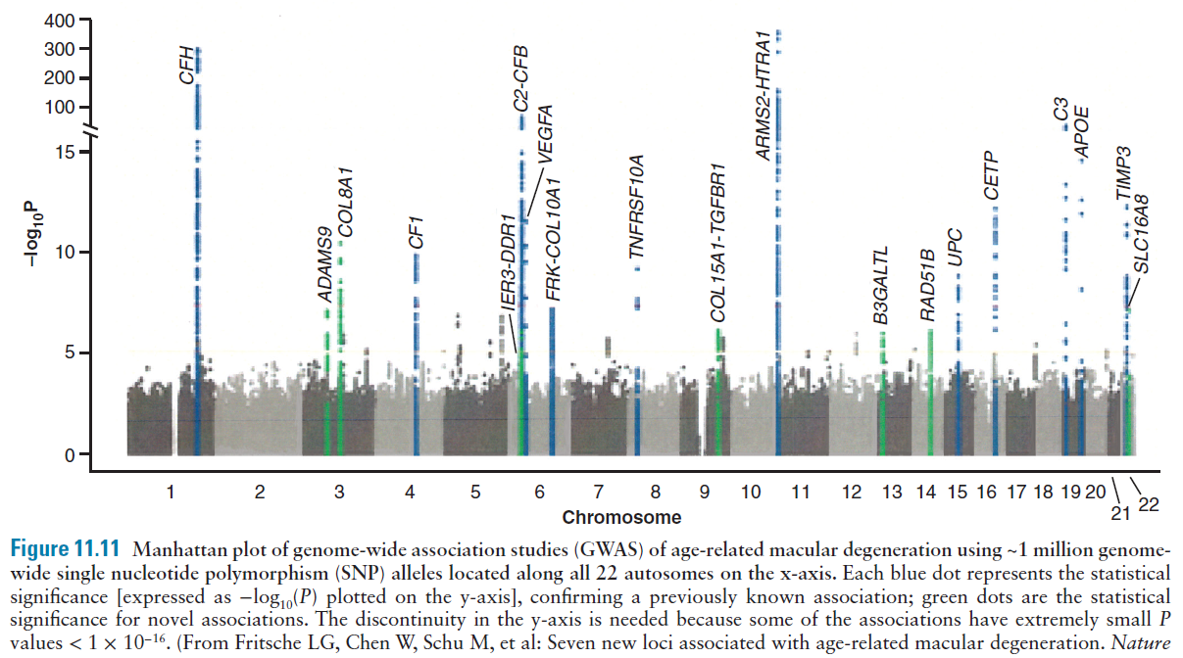

Slide 30
Pitfalls in GWAS
Population stratification
Multiple hypothesis testing (p<5x10⁻⁸)
Replication study to avoid false positives

Slide 31
Importance of associations discovered with GWAS
ORs are a measure of the impact of a specific allele on complex pathogenetic pathways
The subtlety of that impact is determined by how that allele perturbs the biologic function of the gene in which it is located, not by whether the gene harboring that allele might be important in disease pathogenesis
Even if the effect size of any one variant is small, GWAS demonstrate that many of these disorders are indeed extremely polygenic

Slide 32
Importance of associations discovered with GWAS
The genetic architecture for some of the most common complex diseases may involve hundreds to thousands of loci harboring variants of small effect in many genes and pathways
Potential interplay between common and rare variants in disease susceptibility

Slide 33
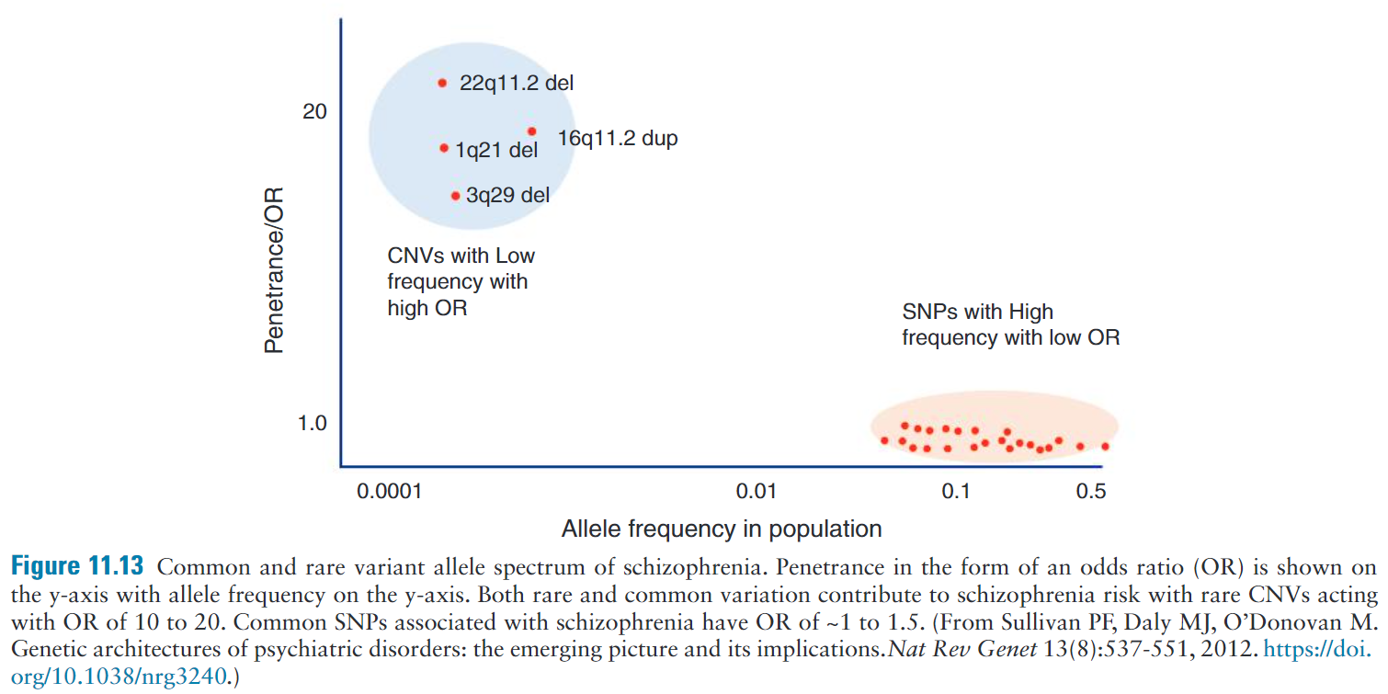
In schizophrenia, identification of both rare variants with high OR and common variants of low OR contributing to risk

Slide 34
Finding genes responsible for disease by genome-wide sequencing
Comparison of exome (ES) and whole genome (GS) sequencing
Design and technical limitations in using ES:
Inability to analyze noncoding changes (e.g. deep intronic or regulatory regions) unless specifically targeted
Dropout of some coding sequence due to capture inefficiencies (high GC content exons)
Limited ability to resolve more complex genetic mechanisms (e.g. structural rearrangements, repeat expansions)

Slide 35
Filtering whole-genome sequence or whole-exome sequence data to find potential causative variants
Location with respect to protein-coding genes
Population frequency. Discard common variants >0.01
Deleterious nature of mutation. Discard synonymous mutations
Consistency with likely inheritance pattern
Finding mutations in the same gene in other patients would confirm it as the responsible gene of disease

Slide 36
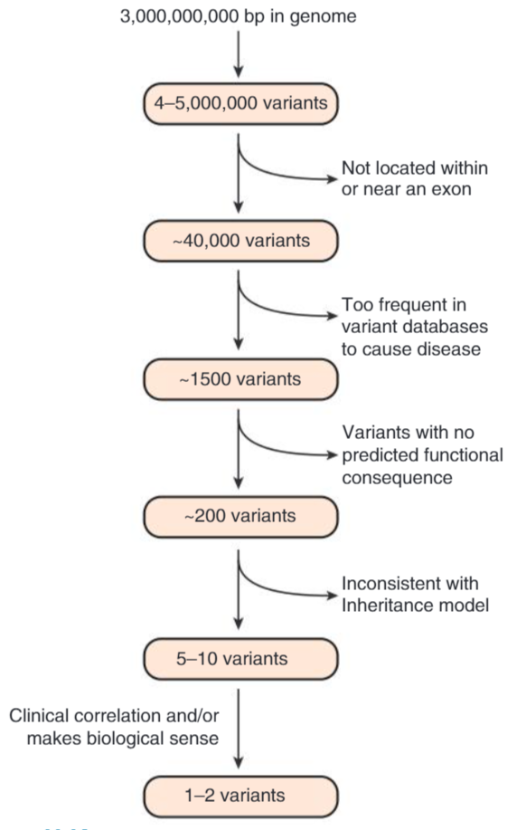
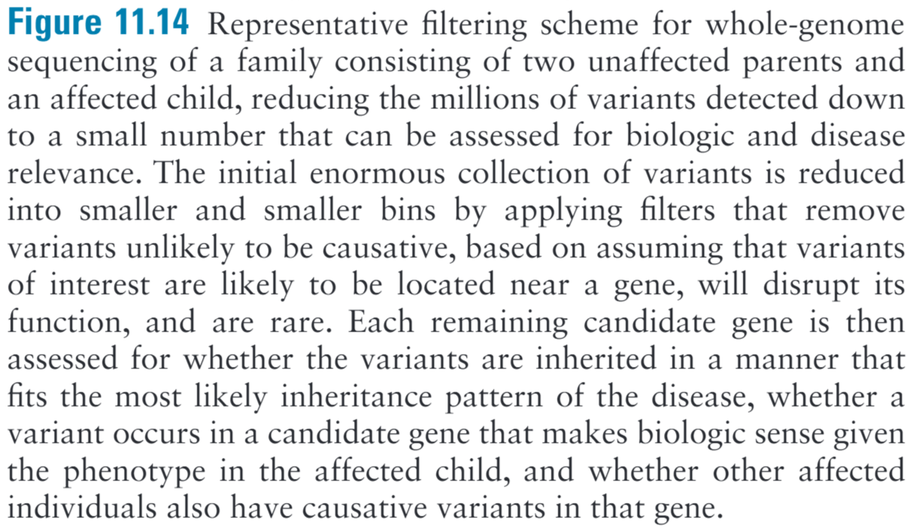

Slide 37
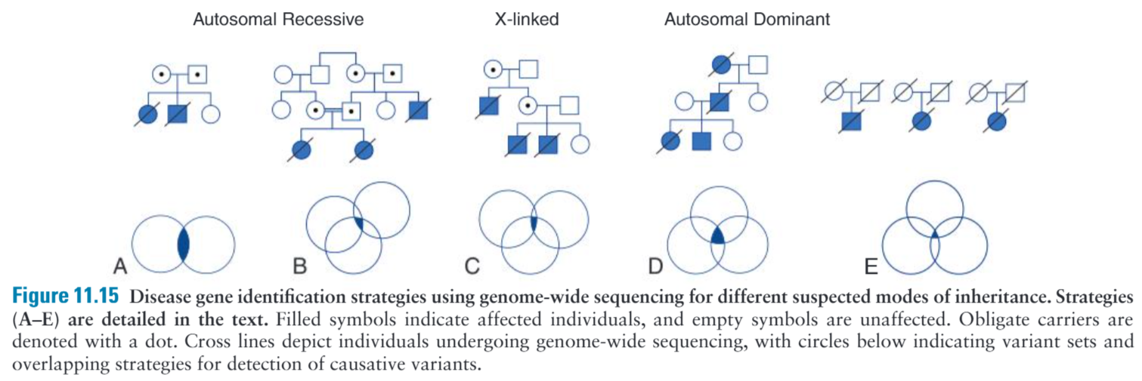
FILTERING STRATIGIES FOR IDENTIFICATION OF DISEASE-CAUSING GENES

Slide 38
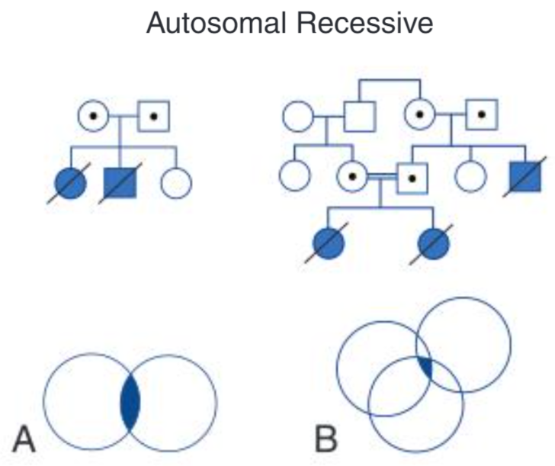
Families with no consanguinity, compound heterozygous is the most likely disease model
Sequencing of affected sibling pairs is highly effective since there are very few shared compound heterozygous variants

Slide 39
Families with consanguinity, causative variants are expected to be homozygous
Sequencing of sibling pairs or other affected relatives and prioritizing homozygous variants
Homozygosity mapping with SNP microarrays to predetermine chromosomal loci with overlapping stretches of homozygosity in affecteds to narrow down regions

Slide 40
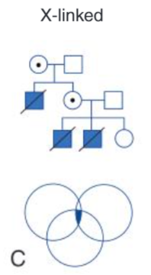
Look for shared variants on X chromosome in males and filter out autosome variants

Slide 41
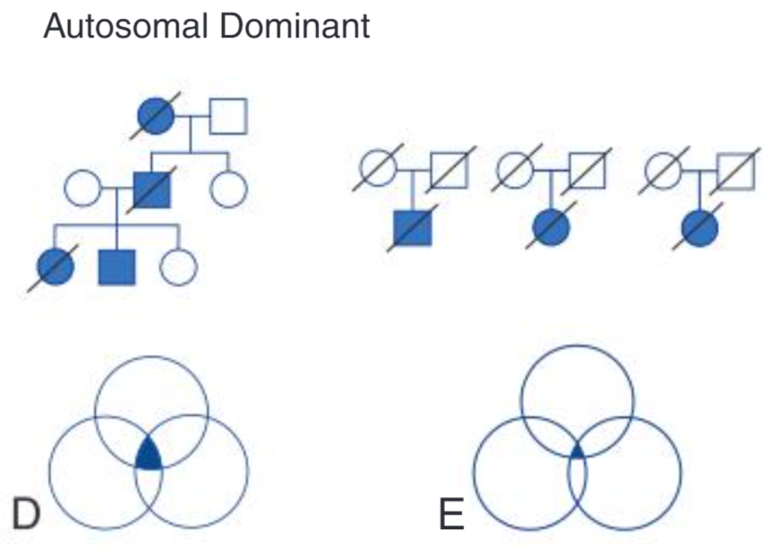
Looking for shared variants in affecteds and excluding variants present in unaffecteds
Many variants are expected, sequencing many individuals is necessary
Linkage analysis can help in defining a disease locus which narrows down region to sequence

Slide 42
De novo dominant variants, severe genetic lethals
Few de novo events per exome (1-2) and genome (50-70)
Overlapping de novo events in two unrelated individuals with a similar phenotype can be sufficient to show disease causation

Slide 43
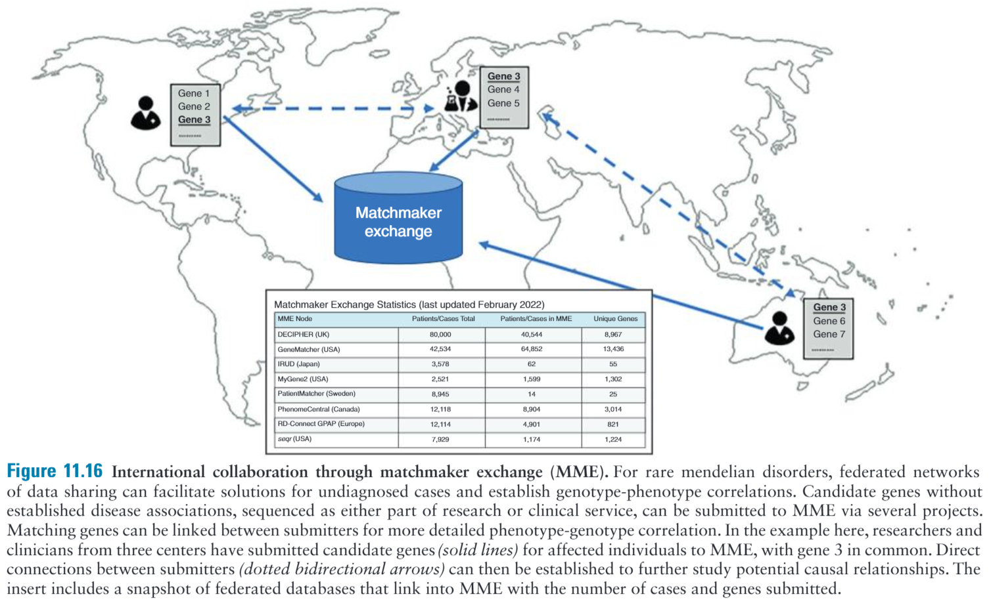
International collaboration is necessary to study exceedingly rare disorders or new disease mechanisms, as no one cohort will likely have the number to make robust disease associations
https://www.matchmakerexchange.org/

Slide 44
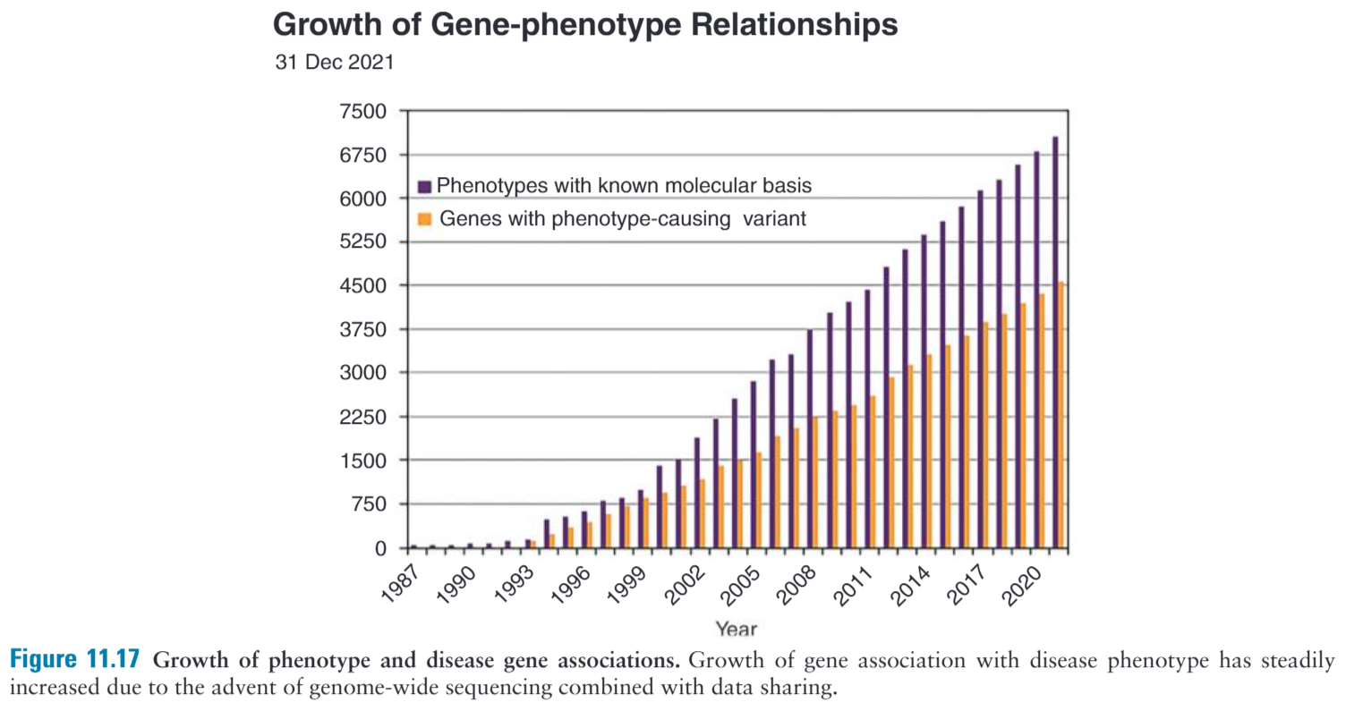
Increased applications of genome-wide sequencing coupled with sharing of data played a pivotal role in understanding gene-disease associations, leading to rapid increase in gene discovery over the last 10+ years

Slide 45
Example: Identification of the Gene Causing Postaxial Acrofacial Dysostosis (POAD)
A family with two affected siblings
Small jaws, missing digits of their hands, underdevelopment of the ulna, cleft lip and clefts of the eyelids
Autosomal recessive:
Some parents are consanguineous
Families with multiple affected siblings born to unaffected parents
4 million variants filtered to 4 candidate genes
DHODH gene had rare damaging variants in two other unrelated individuals with POAD
DHODH encodes dihyroorotate dehydrogenase, a mitochondrial enzyme involved in pyrimidine biosynthesis
Not suspected on biologic grounds to be the gene responsible for this malformation syndrome

Slide 46
Limitation of genome-wide sequencing
Most groups report diagnostic yields in 20-40% range. Reasons:
Some disorders are intractable to standard genome-wide sequencing including methylation disorders or those involving certain types of UPD if parents are not sequenced (i.e. heterodisomy)
Genome-wide sequencing may miss certain classes of variation that are difficult to detect by routine short-read sequencing alone (i.e. balanced changes, repeat expansions)
Variation detected can be difficult to interpret with our current understanding of the genome (noncoding and regulatory genomic regions)
At present, whole genome sequencing cannot actually sequence the entire genome In any one individual

